Slide 1

WEEK 7 Feedback in Amplifiers
Engineering
Electrical Engineering & Telecommunications
Dr. Aron Michael 2023

Slide 2


Slide 3
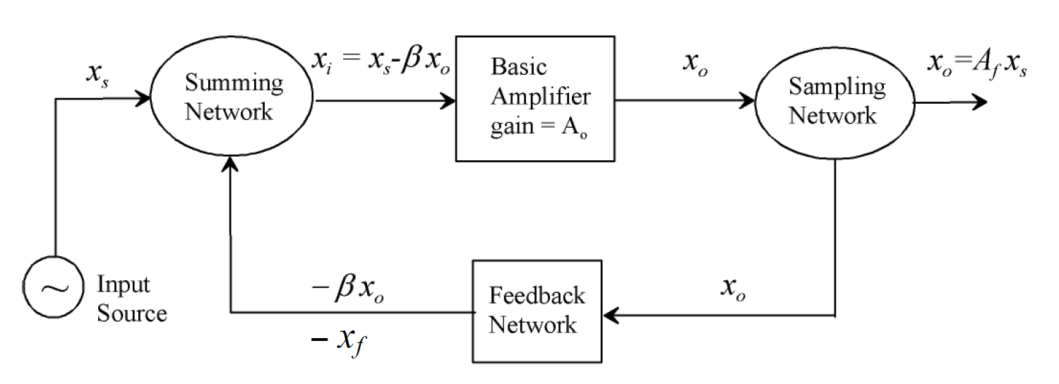
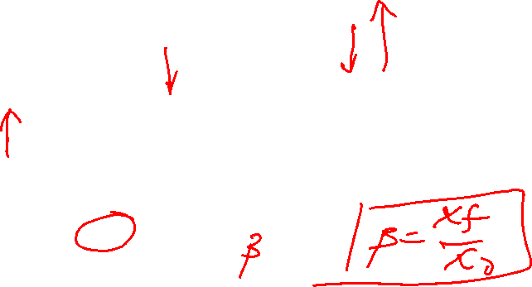

Feedback Concept
Feedback refers to the process whereby a portion of the output is returned to the input to form part of the system excitation
$x_{s},x_{i},x_{0},x_{f}$ are voltage or current signals, $A_{0}$ is open loop amplifier gain and $β$ is feedback factor.

Slide 4



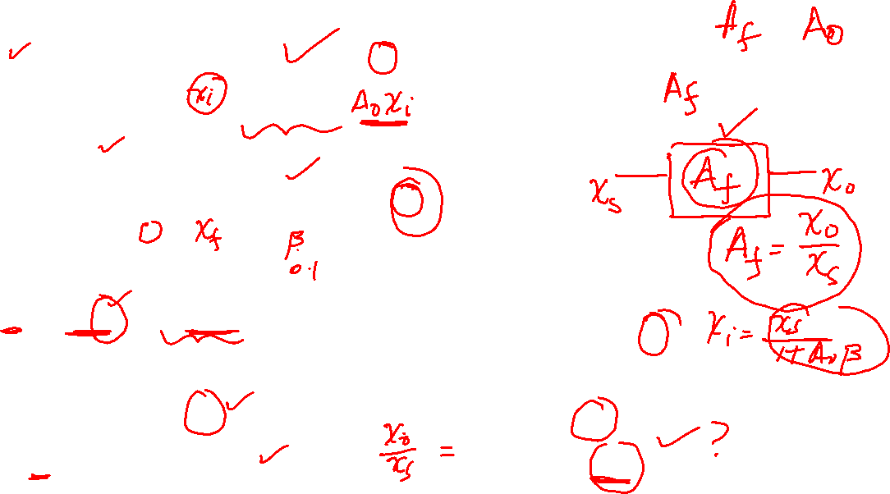

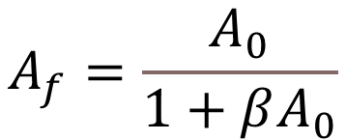
Feedback Concept
Output signal
Feedback signal
Assuming negative feedback
$$x_{f}=βx_{0}=βA_{0}x_{i}$$
$x_{0}=A_{f}x_{s}=$ $A_{0}x_{i}$
$$x_{0}=A_{f}\left(1+A_{0}β\right)x_{i}=A_{0}x_{i}$$
$$x_{i}=x_{s}−x_{f}$$
$$A_{f}=\frac{A_{0}}{1+βA_{0}}$$
$$x_{i}(1+A_{0}β)=x_{S}$$

Slide 5
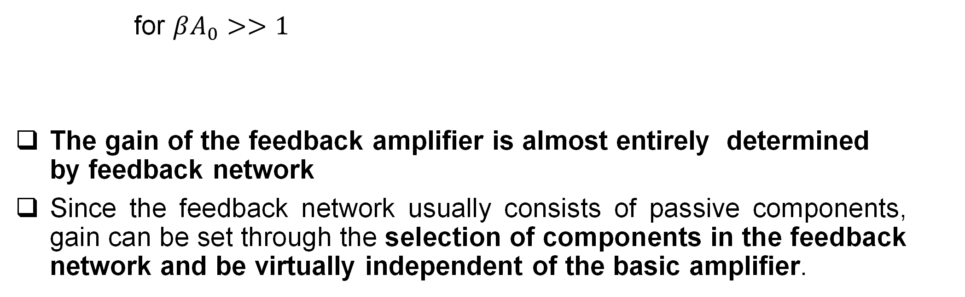
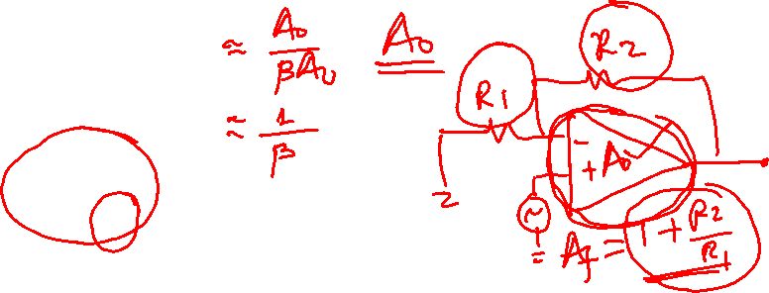
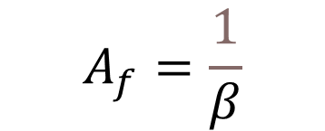
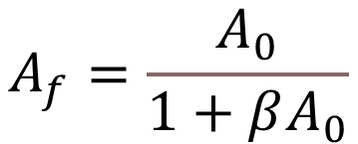
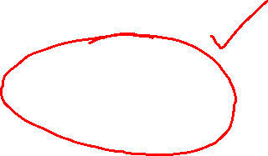
Feedback Concept
$$A_{f}=\frac{A_{0}}{1+βA_{0}}$$
for $βA_{0}>>1$
The gain of the feedback amplifier is almost entirely determined by feedback network
Since the feedback network usually consists of passive components, gain can be set through the selection of components in the feedback network and be virtually independent of the basic amplifier.
$$A_{f}=\frac{1}{β}$$

Slide 6
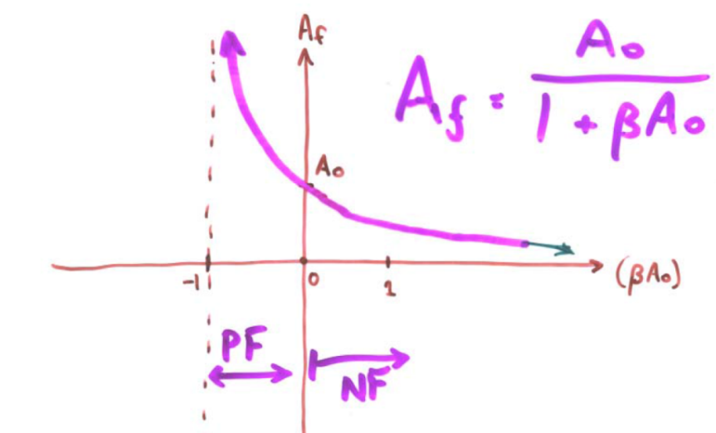
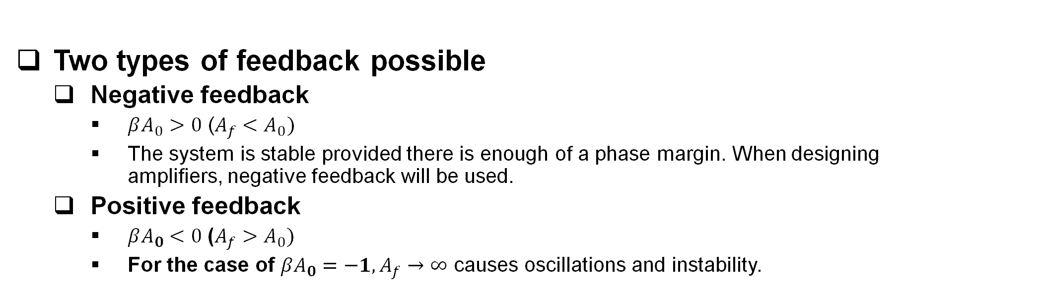
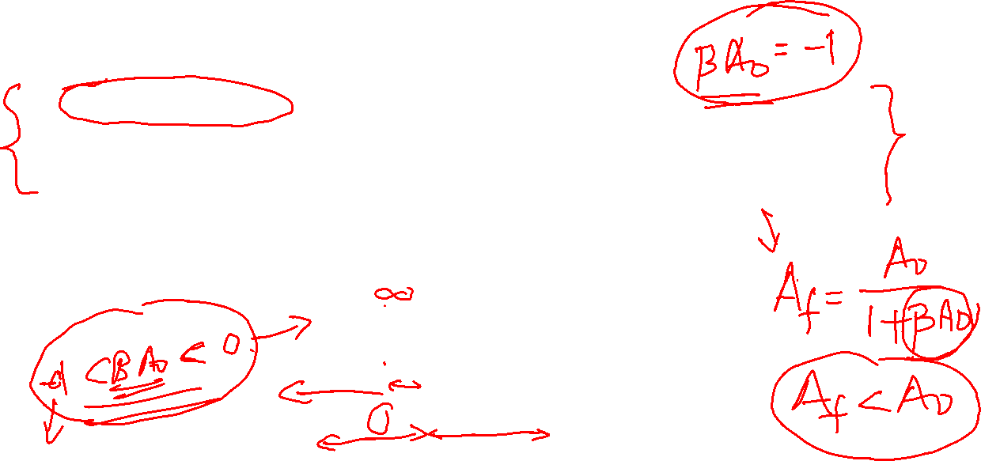
Feedback Type
Two types of feedback possible
Negative feedback
$βA_{0}>0$ ($A_{f}<A_{0})$
The system is stable provided there is enough of a phase margin. When designing amplifiers, negative feedback will be used.
Positive feedback
$βA_{0}<0$ ($A_{f}>A_{0})$
For the case of $βA_{0}=−1, A_{f}→∞$ causes oscillations and instability.

Slide 7


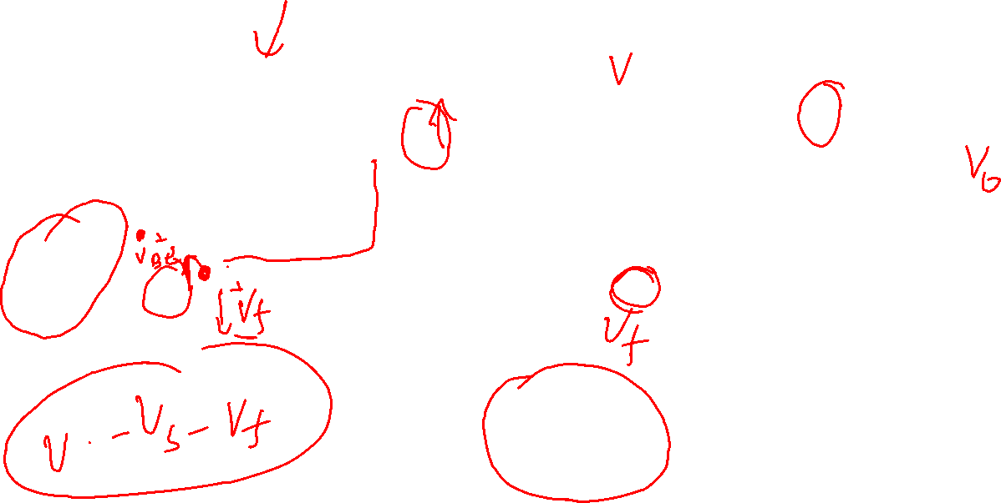
$$A_{f}=\frac{A_{0}}{1+βA_{0}}$$

Slide 8
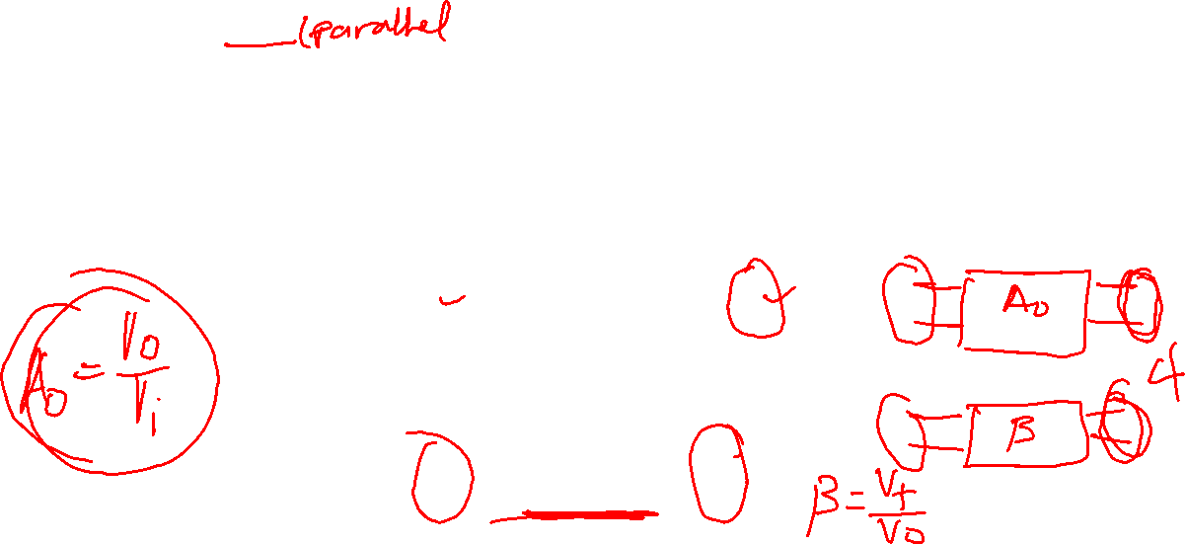
Feedback Topologies
Four feedback topologies are possible
Series-Shunt
Voltage sampled (output) and voltage summed (input)
The basic amplifier is voltage amplifier and the output voltage is sampled (shunt at output) and fed by the feedback network to the input.
The feedback signal is voltage which is added to the source (series at input)

Slide 9
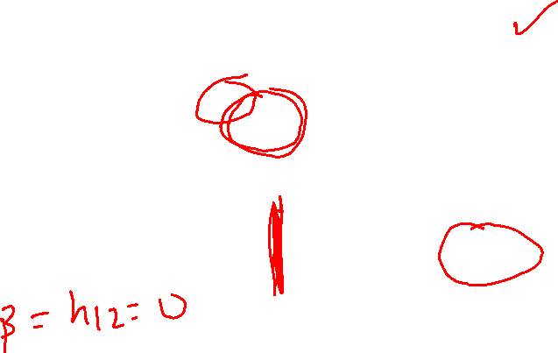
Feedback Topologies
Series-Shunt
The feedback network is a two-port network and can be replaced by one of the two-port network parameters. (which one is appropriate?)
Since series at the input (port 1) and parallel at output (port 2), h-parameter (hybrid parameter) is appropriate.

Slide 10
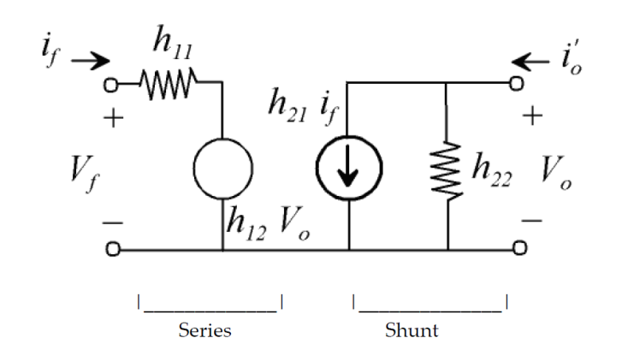
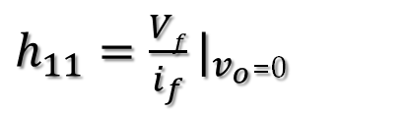
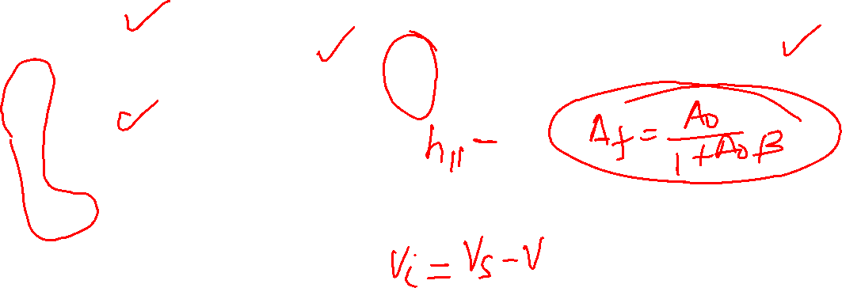
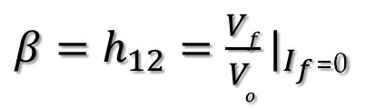

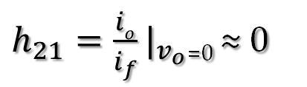
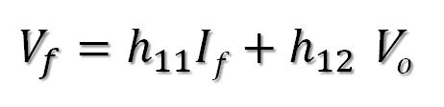
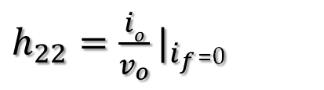
Feedback Topologies
Hybrid Parameters
$h_{11}=\frac{Vf}{i_{f}}|_{v_{o}}$₌₀
$h_{22}=\frac{io}{v_{o}}|_{i_{f}}$₌₀
$V_{f}=h_{11}If+h_{12}$ V$o$
$$I_{o}=h_{21}If+h_{22} Vo$$
${β=h}_{12}=\frac{Vf}{V_{o}}|_{I_{f}}$₌₀
$h_{21}=\frac{io}{i_{f}}|_{v_{o}}$₌₀ ≈ 0
series
shunt

Slide 11
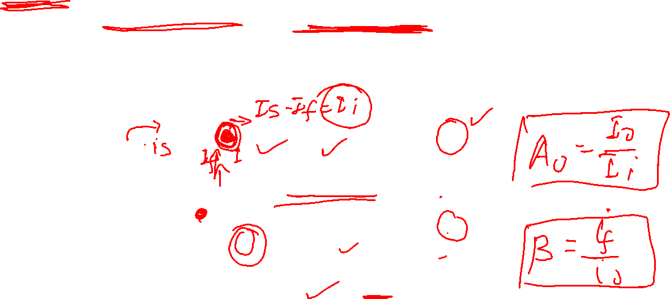
Feedback Topologies
Shunt-Series
Current sampled (output) and current summed (input)
The basic amplifier is current amplifier and the output current is sampled (series at output) and fed by the feedback network.
The feedback signal is current which is summed to the source in parallel (shunt at input)

Slide 12
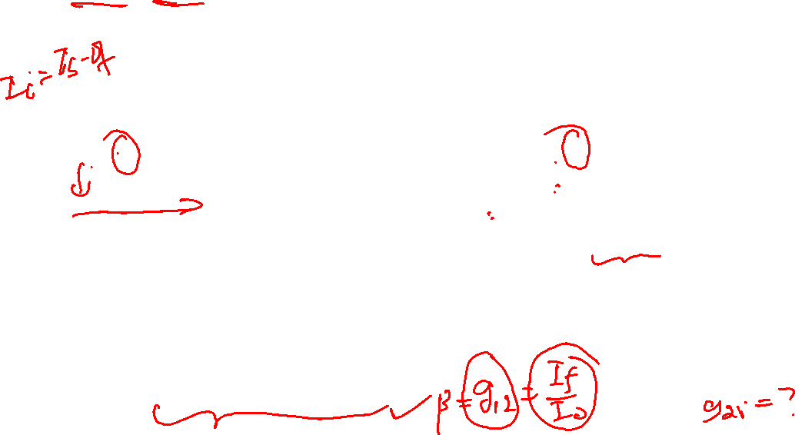
Feedback Topologies
Shunt-Series
The feedback network is a two-port network and can be replaced by one of the two-port network parameters. (which one is appropriate?)
Since shunt (parallel) at the input (port 1) and series at output (port 2), g-parameter is more appropriate.

Slide 13
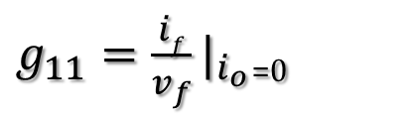
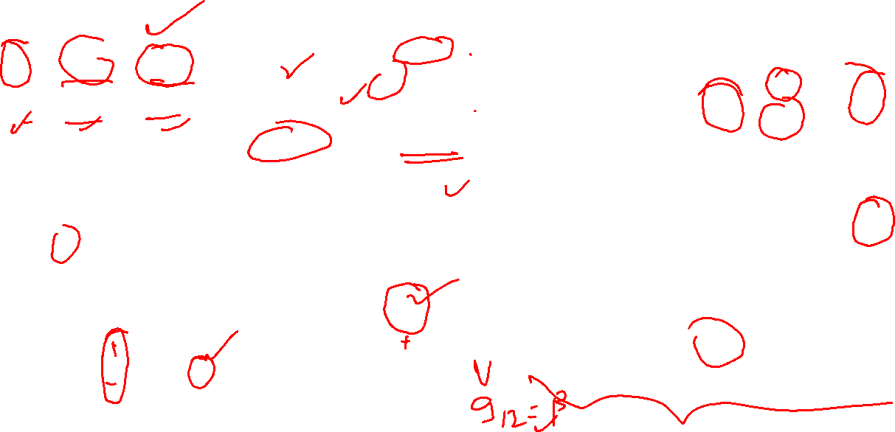
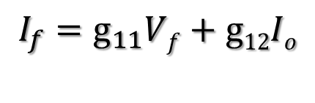
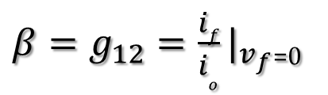
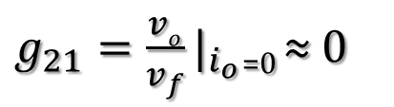

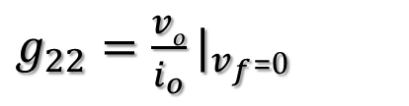
Feedback Topologies
g- Parameters
$g_{11}=\frac{if}{v_{f}}|_{i_{o}}$₌₀
$g_{22}=\frac{vo}{i_{o}}|_{v_{f}}$₌₀
$$I_{f}=g_{11}Vf+g12Io$$
$$V_{o}=g_{21}Vf+g_{22} Io$$
${β=g}_{12}=\frac{if}{i_{o}}|_{v_{f}}$₌₀
$g_{21}=\frac{vo}{v_{f}}|_{i_{o}}$₌₀ ≈ 0

Slide 14
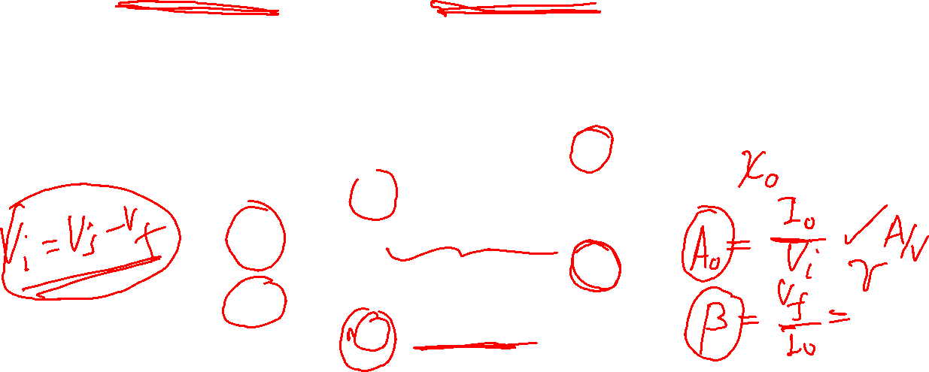
Feedback Topologies
Series-Series
Current sampled (output) and voltage summed (input)
The basic amplifier is transconductance amplifier and the output current is sampled (series at output) and fed by the feedback network at the input.
The feedback signal is voltage which is summed to the source in series (Series at input)

Slide 15
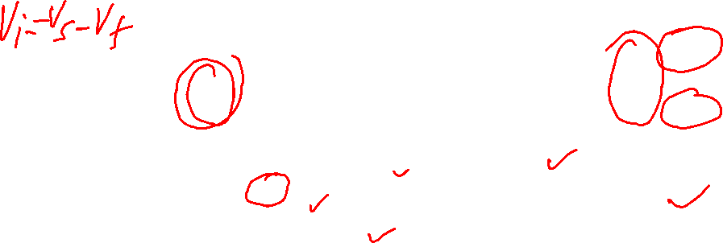
Feedback Topologies
Series-Series
The feedback network is a two-port network and can be replaced by one of the two-port network parameters. (which one is appropriate?)
Since series (parallel) at the input (port 1) and series at output (port 2), z-parameter is more appropriate.

Slide 16

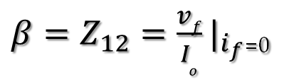
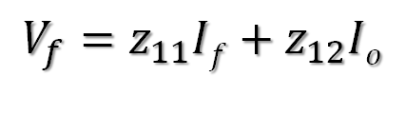
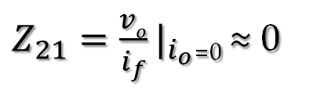
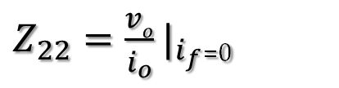
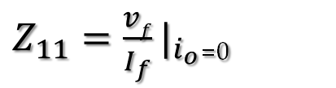
Feedback Topologies
Impedance Parameters
$Z_{22}=\frac{vo}{i_{o}}|_{i_{f}}$₌₀
$Z_{11}=\frac{vf}{I_{f}}|_{i_{o}}$₌₀
$$V_{f}=z_{11}If+z_{12}Io$$
${β=Z}_{12}=\frac{vf}{I_{o}}|_{i_{f}}$₌₀
$Z_{21}=\frac{vo}{i_{f}}|_{i_{o}}$₌₀ ≈ 0
$V_{o}=z_{21}If+z_{22}$ $Io$

Slide 17
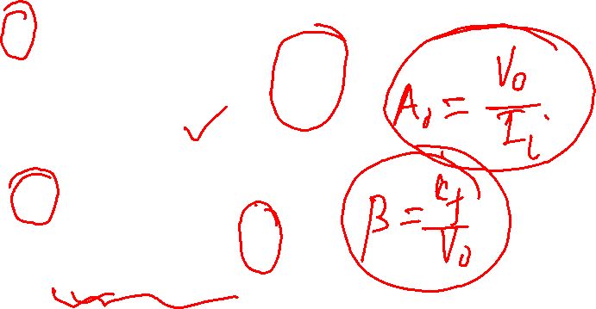
Feedback Topologies
Shunt-Shunt
Voltage sampled (output) and current summed (input)
The basic amplifier is transimpedance amplifier and the output voltage is sampled (shunt at output) and fed by the feedback network at the input.
The feedback signal is current which is summed to the source in parallel (Shunt at input)

Slide 18
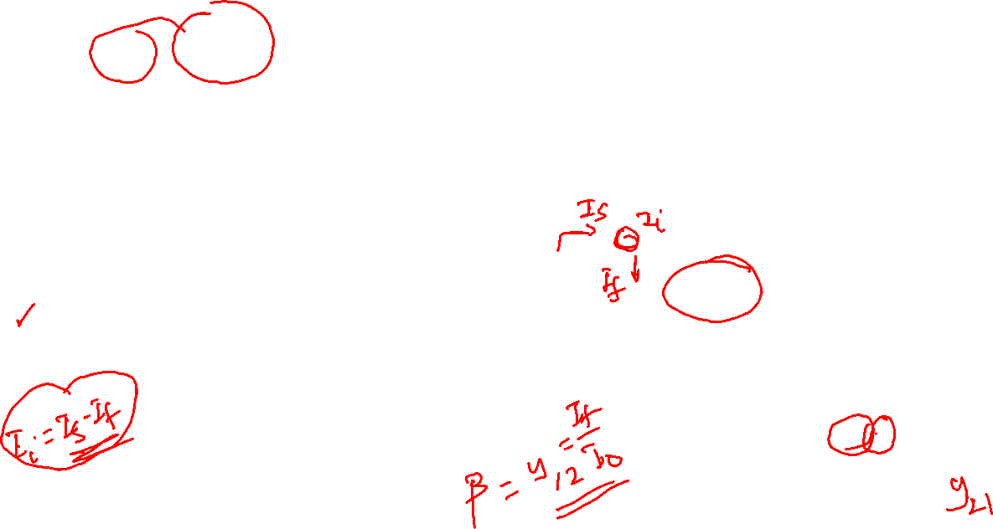
Feedback Topologies
Shunt-Shunt
The feedback network is a two-port network and can be replaced by one of the two-port network parameters. (which one is appropriate?)
Since shunt (parallel) at the input (port 1) and shunt at output (port 2), y-parameter ( admittance parameter) is more appropriate.

Slide 19
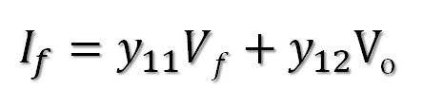
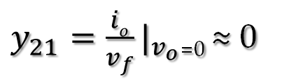
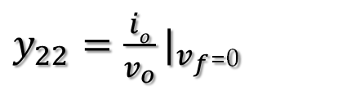
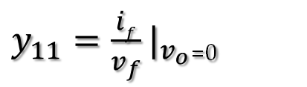
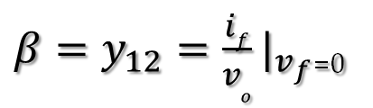
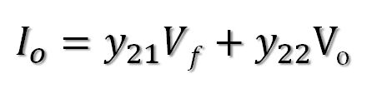
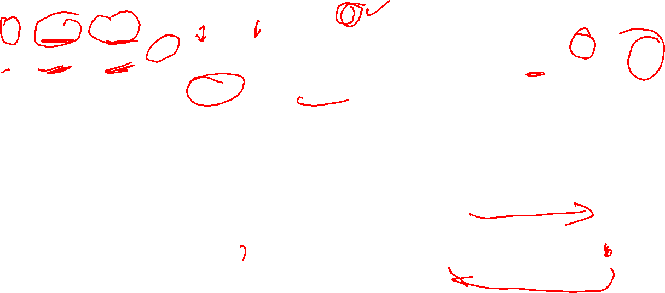
Feedback Topologies
Admittance Parameters
$y_{22}=\frac{io}{v_{o}}|_{v_{f}}$₌₀
$y_{11}=\frac{if}{v_{f}}|_{v_{o}}$₌₀
$I_{f}=y_{11}Vf+y_{12}$V_{o}
$I_{o}=y_{21}Vf+y_{22}$V_{o}
${β=y}_{12}=\frac{if}{v_{o}}|_{v_{f}}$₌₀
$y_{21}=\frac{io}{v_{f}}|_{v_{o}}$₌₀ ≈ 0

Slide 20
Determining Feedback Topology
Assumptions
The basic amplifier is unilateral.
The feedback network is unilateral – that is feed-forward transmission through the network is negligible ( Z₂₁,Y₂₁, h₂₁, and g₂₁ are zero).
For input side, define INPUT NODE
INPUT NODE is either the base of the BJT or the gate of the MOSFET or inverting terminal of a differential or an operational amplifier to which the current source send a current.
If there exists a connection between the input node and output circuit, then the topology is identified as SHUNT. Otherwise, the topology at the input side is SERIES.
Alternatively define INPUT LOOP
INPUT LOOP is a loop that contains the applied voltage source, the base-to-emitter of a BJT or two inputs of a differential or an operational amplifier or gate source of a MOSFET.

Slide 21
Determining Feedback Topology
If the INPUT LOOP also contains a section of the feedback network or a section which is connected to the output), the feedback network is connected in SERIES at the input side. Otherwise, it is a SHUNT topology.
For output side, define OUTPUT NODE
OUTPUT NODE is the node to which the load of the amplifier is connected to (often defined as V_{o}).
If there exists a connection between the output node and feedback network, then the topology is identified as SHUNT. Otherwise, the topology at the input side is SERIES.
In other words, if the feedback signal becomes zero when Vo is set to zero, then the topology is SHUNT.

Slide 22
Determining Feedback Topology
Alternatively define OUTPUT LOOP
OUTPUT LOOP is a loop in which the output current I_{o} flows. It contains the load.
If the OUTPUT LOOP also contains a section of the feedback network, then the topology is identified as SERIES at the output. Otherwise, it is a SHUNT topology.
In other words, If the feedback signal becomes zero when I_{o} is set to zero, then the topology is identified as SERIES at the output.

Slide 23
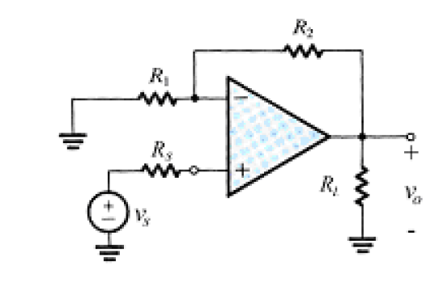

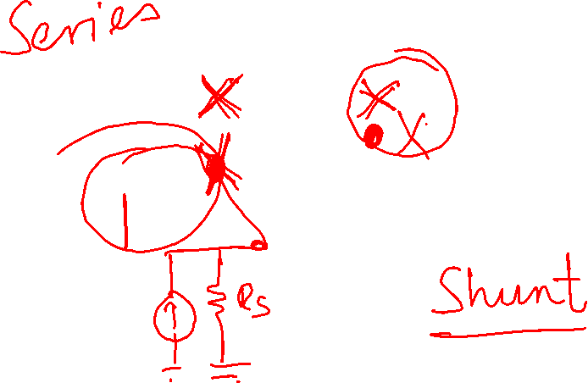


Determining Feedback Topology
Example

Slide 24
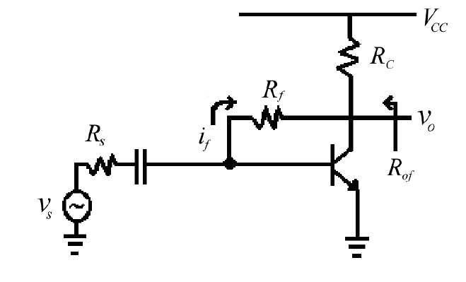


Determining Feedback Topology
Example

Slide 25


Determining Feedback Topology
Example

Slide 26

Determining Feedback Topology
Example

Slide 27
Determining Feedback Topology
Example

Slide 28







Determining Feedback Topology
Example

Slide 29









Determining Feedback Topology
Example

Slide 30

Properties of Negative Feedback
Gain De-sensitivity
This means that for negative feedback (β>0) the change in A_{f} will be less sensitive to changes in A by the factor (1+ Aβ).

Slide 31

Properties of Negative Feedback
Example

Slide 32

Properties of Negative Feedback
Reduction in non-linear distortion
The transfer characteristics of amplifiers is linear only in certain regions.
The range of inputs for which the amplifiers remain in linear region can be maximized by applying feedback

Slide 33



Properties of Negative Feedback
Noise reduction
Assume that the signal-to-noise ratio for an amplifier A₁ is taken to be:
Precede A₁ by low noise amplifier A_{2,}
The signal-to-noise ratio for the total system is then given by

Slide 34



Properties of Negative Feedback
Bandwidth extension
Consider an amplifier that can be characterised with a single-pole function
With feedback applied, the gain function is given by

Slide 35




Properties of Negative Feedback
The high corner frequency for the amplifier with feedback is then given by function
By a similar argument for low frequency corner, it can be shown that
The bandwidth of the amplifier (ω_{H} – ω_{L}) has been increased by the feedback factor of (1 +β$A_{o}$)

Slide 36



Properties of Negative Feedback
Effect of input impedance
If feedback signal is a voltage in series with input, the input impedance is increased by the factor (1+βA).

Slide 37


Properties of Negative Feedback
Effect of input impedance
If feedback signal is a current in shunt at the input, the input impedance is decreased by the factor (1+βA).

Slide 38






Properties of Negative Feedback
Effect of output impedance
If feedback configuration is a shunt connection (voltage sampling) , the output impedance is reduced by the factor (1+βA).

Slide 39






Properties of Negative Feedback
Effect of output impedance
If feedback configuration is a series connection (current sampling), the output impedance is increased by the factor (1+βA).

Slide 40

Analysis of Feedback Amplifiers
General analysis steps
Step 1
Identify the feedback topology
Step 2
Redraw the basic amplifier in a form suitable for small-signal analysis including the loading effect of the feedback network on the input and output sections of the basic amplifier. It should be noted that
y₁₁, h₁₁, z₁₁ or g₁₁ of the appropriate two-port parameter for the feedback network represents the loading effect of the feedback network at the input section.
y₂₂, h₁₁, z₂₂ and g₂₂ of the appropriate two-port parameter for the feedback network represents the loading effect of the feedback network at the output section.

Slide 41
Analysis of Feedback Amplifiers
Shunt-shunt topology
Note
y₁₁ represents the loading effect of the feedback network at the input side.
y₂₂ represents the loading effect of the feedback network at the output side.
y₁₁ and y₂₂ are connected in parallel at the input and output sides respectively.
The source is current source – voltage source needs to be converted to current source.

Slide 42
Analysis of Feedback Amplifiers
Series-series
Note
z₁₁ represents the loading effect of the feedback network at the input side.
z₂₂ represents the loading effect of the feedback network at the output side.
z₁₁ and z₂₂ are connected in series at the input and output sides, respectively.
The source is voltage source – current source needs to be converted to voltage source.

Slide 43

Analysis of Feedback Amplifiers
Shunt-series
Note
g₁₁ represents the loading effect of the feedback network at the input side.
g₂₂ represents the loading effect of the feedback network at the output side.
g₁₁ is connected in parallel at the input side and g₂₂ is connected in series at the output side, respectively.
The source is current source – voltage source needs to be converted to current source.

Slide 44

Analysis of Feedback Amplifiers
Series-shunt
Note
h₁₁ represents the loading effect of the feedback network at the input side.
h₂₂ represents the loading effect of the feedback network at the output side.
h₁₁ is connected in series at the input side and h₂₂ is connected in parallel at the output side, respectively.
The source is voltage source – current source needs to be converted to voltage source.

Slide 45


Analysis of Feedback Amplifiers
Step 3
Identify $x_{0}$ and $x_{f}$ to evaluate the feedback factor $β=\frac{x_{f}}{x_{0}}$ . Note that the feedback factor $β$ corresponds to y₁₂, g₁₂, z₁₂ and h₁₂.
Step 4
Evaluate the open loop gain $A_{0}L$. The form of $A_{0}L$will depend on the topology.
Step 5
Evaluate the input and output impedances of the basic amplifier with the loading effects of the feedback network included.

Slide 46




Analysis of Feedback Amplifiers
Step 6
Evaluate the following
Loop gain $βA_{0}L$
Closed loop gain
Input and output impedances using equations discussed previously
$$A_{f}=\frac{A_{0}}{1+βA_{0L}}$$

Slide 47

Analysis of Feedback Amplifiers
Example 1:
Step 1: Identify the feedback topology
Shunt (at the input) - current is fed at INPUT NODE and hence current is summed at the INPUT NODE
Shunt (at the output) - V_{o} is sampled from the OUTPUT NODE. If V_{o} = 0, feedback current will be disabled.

Slide 48










Analysis of Feedback Amplifiers
Step 2: Redraw circuit for small-signal analysis considering loading
effects

Slide 49

Analysis of Feedback Amplifiers

Slide 50



Analysis of Feedback Amplifiers
Step 2 (continue….)
Step 3: Identify $x_{0}$ and $x_{f}$ to evaluate the feedback factor $β=\frac{x_{f}}{x_{0}}$.

Slide 51




Analysis of Feedback Amplifiers
Step 4: Evaluate the open loop gain $A_{OL}$. In this case, $A_{OL}$ is trans-impedance gain
and therefore

Slide 52







Analysis of Feedback Amplifiers
Step 5: Evaluate the input and output impedances of the basic amplifier with the
loading effects of the feedback network included
Step 6: Evaluate the closed-loop gain, closed-loop input, and output impedances the
loading effects of the feedback network included

Slide 53




Analysis of Feedback Amplifiers
Example 2:
Step 1: Identify the feedback topology
Series (at the input) - feedback voltage is summed in INPUT LOOP.
Series (at the output) - I_{o} is sampled from the OUTPUT LOOP. If I_{o} = 0, feedback voltage will be disabled.

Slide 54





Analysis of Feedback Amplifiers
Step 2: Redraw circuit for small-signal analysis considering loading
effects

Slide 55


Analysis of Feedback Amplifiers

Slide 56



Analysis of Feedback Amplifiers
Step 2 (continue….)
Step 3: Identify $x_{0}$ and $x_{f}$ to evaluate the feedback factor $β=\frac{x_{f}}{x_{0}}$.

Slide 57





Analysis of Feedback Amplifiers
Step 4: Evaluate the open loop gain $A_{OL}$. In this case, $A_{OL}$ is trans-impedance gain
and therefore

Slide 58



Analysis of Feedback Amplifiers
Step 5: Evaluate the input and output impedances of the basic amplifier with the
loading effects of the feedback network included

Slide 59









Analysis of Feedback Amplifiers
Step 6: Evaluate the closed-loop gain, closed-loop input, and output impedances the
loading effects of the feedback network included
This however has included the source resistance, which we should subtract to get the input impedance
$R_{ⅈf}^{′}=r_{π}+\left(1+h_{fe}\right)R_{e}$
$$R_{ⅈf}^{′}=R_{l\dot{f}}−R_{s}^{′}$$

Slide 60





Analysis of Feedback Amplifiers
Example 3:
Step 1: Identify the feedback topology
Series (at the input) - feedback voltage is summed in INPUT LOOP.
Shunt (at the output) - V_{o} is sampled at the OUTPUT NODE. If V_{o} = 0, feedback voltage will be disabled.

Slide 61




Analysis of Feedback Amplifiers
Step 2: Redraw circuit for small-signal analysis considering loading
effects
Since Series-shunt, the appropriate two-port network is h-parameter

Slide 62

Analysis of Feedback Amplifiers

Slide 63



Analysis of Feedback Amplifiers
Step 2 (continue….)
Step 3: Identify $x_{0}$ and $x_{f}$ to evaluate the feedback factor $β=\frac{x_{f}}{x_{0}}$.

Slide 64



Analysis of Feedback Amplifiers
Step 4: Evaluate the open loop gain $A_{OL}$. In this case, $A_{OL}$ is trans-impedance gain
and therefore

Slide 65



Analysis of Feedback Amplifiers
Step 5: Evaluate the input and output impedances of the basic amplifier with the
loading effects of the feedback network included

Slide 66






Analysis of Feedback Amplifiers
Step 6: Evaluate the closed-loop gain, closed-loop input, and output impedances the
loading effects of the feedback network included
This however has included the source resistance, which we should subtract to get the input impedance
This however has included the load resistance, which we should subtract to get the output impedance
$$R_{ⅈf}^{′}=R_{l\dot{f}}−R_{s}^{′}$$

Slide 67


Analysis of Feedback Amplifiers
Example 4:
Step 1: Identify the feedback topology
Shunt (at the input) - feedback current is summed at INPUT NODE.
Shunt (at the output) - I_{o} is sampled at the OUTPUT NODE. If I_{o} = 0, feedback current will be disabled.

Slide 68

Analysis of Feedback Amplifiers

Slide 69





Analysis of Feedback Amplifiers
Step 2: Redraw circuit for small-signal analysis considering loading
effects
Since Series-shunt, the appropriate two-port network is g-parameter

Slide 70

Analysis of Feedback Amplifiers

Slide 71



Analysis of Feedback Amplifiers
Step 2 (continue….)
Step 3: Identify $x_{0}$ and $x_{f}$ to evaluate the feedback factor $β=\frac{x_{f}}{x_{0}}$.

Slide 72





Analysis of Feedback Amplifiers
Step 4: Evaluate the open loop gain $A_{OL}$. In this case, $A_{OL}$ is trans-impedance gain
and therefore

Slide 73

Analysis of Feedback Amplifiers

Slide 74



Analysis of Feedback Amplifiers
Step 4 (continue….)

Slide 75




Analysis of Feedback Amplifiers
Step 5: Evaluate the input and output impedances of the basic amplifier with the
loading effects of the feedback network included

Slide 76





Analysis of Feedback Amplifiers
Step 6: Evaluate the closed-loop gain, closed-loop input, and output impedances the
loading effects of the feedback network included
This however has included the source resistance, which we should subtract to get the input impedance
This however has included the load resistance, which we should subtract to get the output impedance
$$R_{ⅈf}^{′}={\left(\frac{1}{R_{if}}−\frac{1}{R_{s}}\right)}^{−1}$$
$$R_{0}f=R_{if}−R_{C2}$$

Slide 77


Analysis of Feedback Amplifiers (Lab 2)

Slide 78

Analysis of Feedback Amplifiers (Lab 2)

Slide 79

Analysis of Feedback Amplifiers (Lab 2)

Slide 80


Hints and Summary
General hints for determining the feedback topology of feedback amplifiers (Aron’s rule)
Locate the feedback element – it is typically a resistor sometimes with a capacitor in series and usually named as Rf.
Locate where the input end of the element is. If it is connected to the INPUT NODE, then it is SHUNT. Otherwise, it is SERIES.
Locate the output end of the element. If it is connected to the OUTPUT NODE, then it is probably SHUNT. Otherwise, it is SERIES.

Slide 81









Hints and Summary
Topology | Amplifier Type | Summed signal | Sampled signal | Rif | Rof
Shunt-Shunt | current-voltage | current | voltage | Low | Low
Shunt-Series | current-current | current | current | Low | High
Series-Series | voltage-current | voltage | current | High | High
Series-Shunt | voltage-voltage | voltage | voltage | High | Low
$$R_{if}=\frac{R_{i}}{1+βA_{0L}}$$
$$R_{of}=\frac{R_{o}}{1+βA_{0L}}$$
$$R_{if}=\frac{R_{i}}{1+βA_{0L}}$$
$$R_{of}=R_{0}\left(1+BA_{0L}\right)$$
$$R_{if}=R_{i}\left(1+BA_{0L}\right)$$
$$R_{of}=R_{0}\left(1+BA_{0L}\right)$$
$$R_{of}=\frac{R_{o}}{1+βA_{0L}}$$
$$R_{if}=R_{i}\left(1+BA_{0L}\right)$$

